Slide 1
Coca-Cola Retailer Analysis
Prepared by
Divya Shree

Slide 2
content
Introduction on Coca-Cola Retail Analysis.
Tools used
Steps followed
Analysis
Findings
Dashboard

Slide 3
Introduction on Coca-Cola Retail Analysis
Coca-Cola retail analysis in data Analytics involves examining sales data, customer behavior, and market trends to inform business decisions by creating dashboard.

Slide 4
Tools used
Excel

Slide 5
Steps followed
Analysing the data(columns, beverage product, retailers, region, units sold, total sales ,…etc.,
Create pivot tables
Create charts and maps
All charts and slicers were organised and formatted
Calculate average operation margin, operation profit, total sales, units sold.

Slide 6
Findings:
Total Sales : $2,08,540
Units Sold : 5,03,100
Operation profit : $82,971
Operation Margin : 39.8%

Slide 7
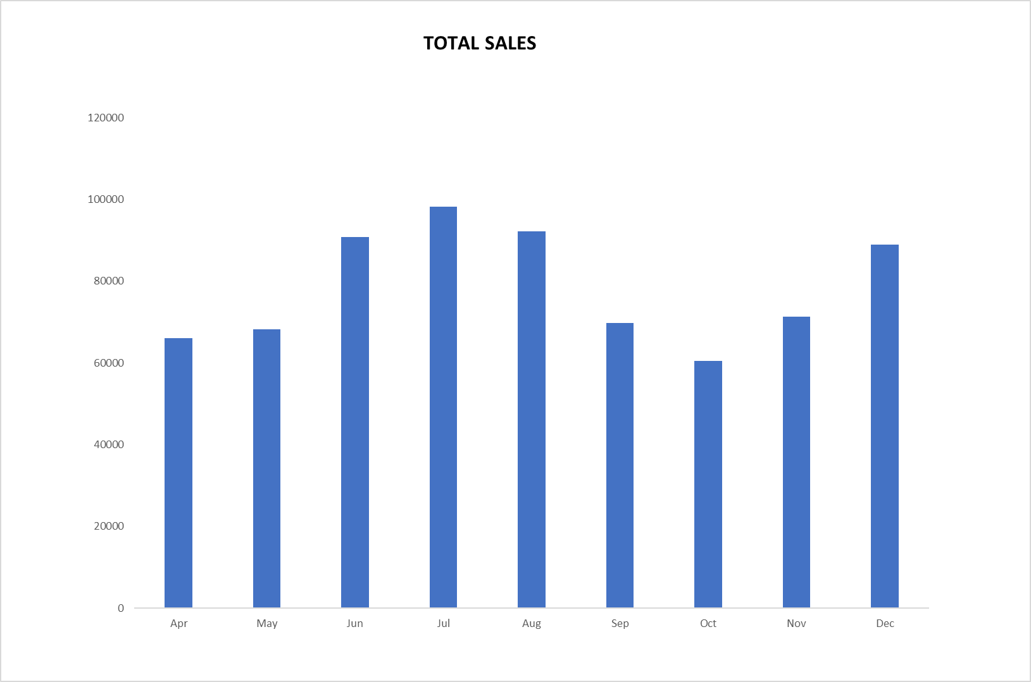
Total sales
In this graph we can see retailer named fizzysip in west region, where the beverage brand is Coca-Cola.
From April to December, more sales have been in July with the value 98250. And least sales happened in October with the value 60500

Slide 8
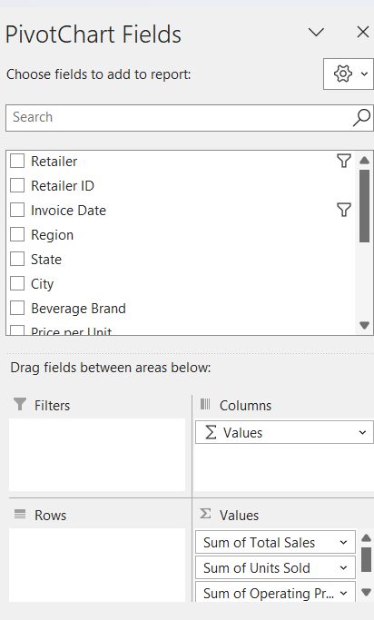


total sales, units sold, operating profit, operating margin

Slide 9
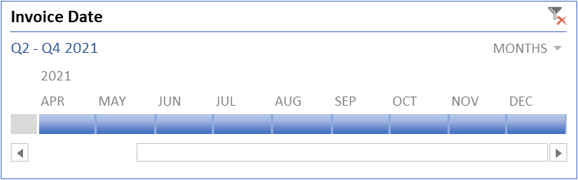
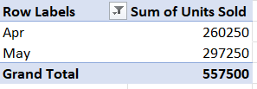
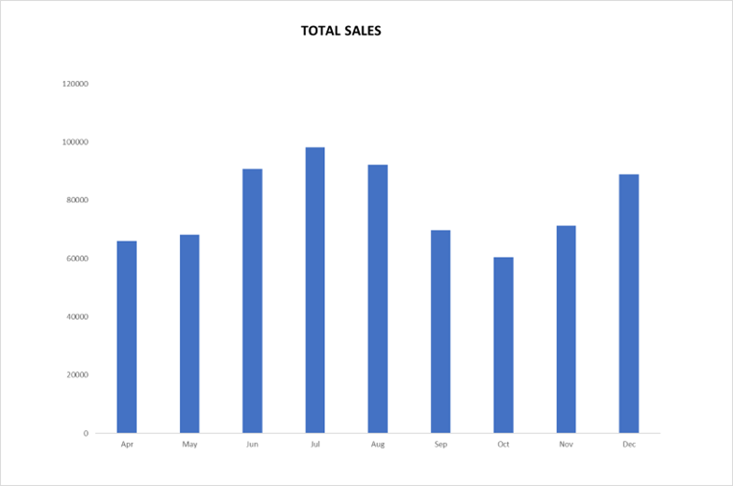
Units Sold by Months
Clustered column chart (total)

Slide 10
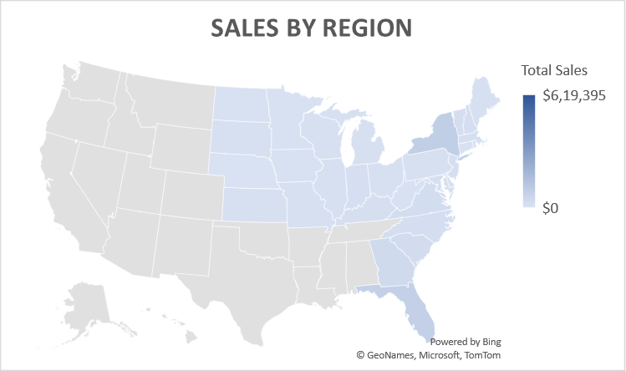
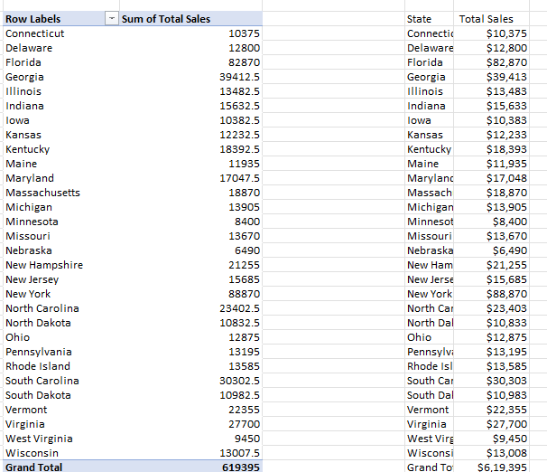
Sum of total sales by States
Filled map(sales by region)

Slide 11
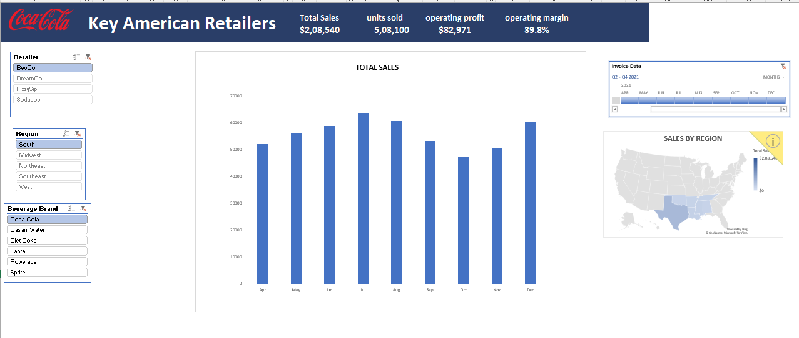
Dashboard
A dashboard is a single page report showing all the important values related to the business.

Slide 12
Thank you

